Slide 1
ECG spectrogram scalogram

Slide 2
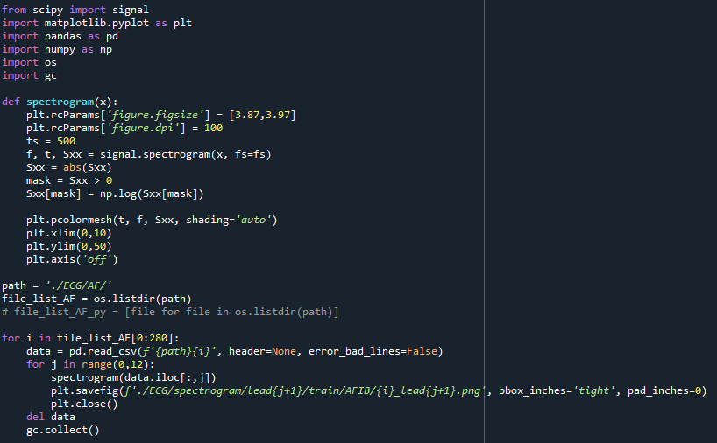
ECG spectrogram code

Slide 3
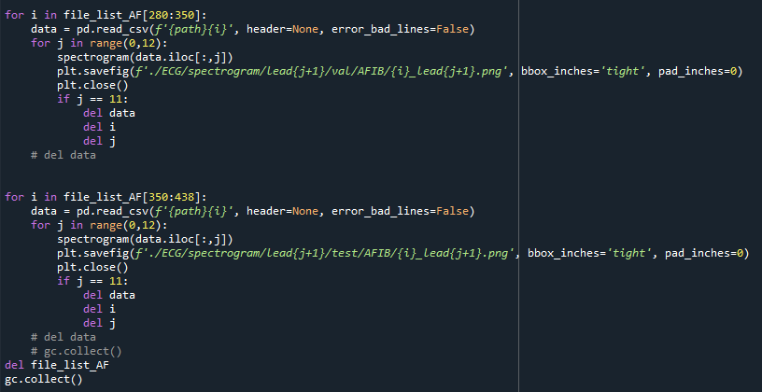

Slide 4
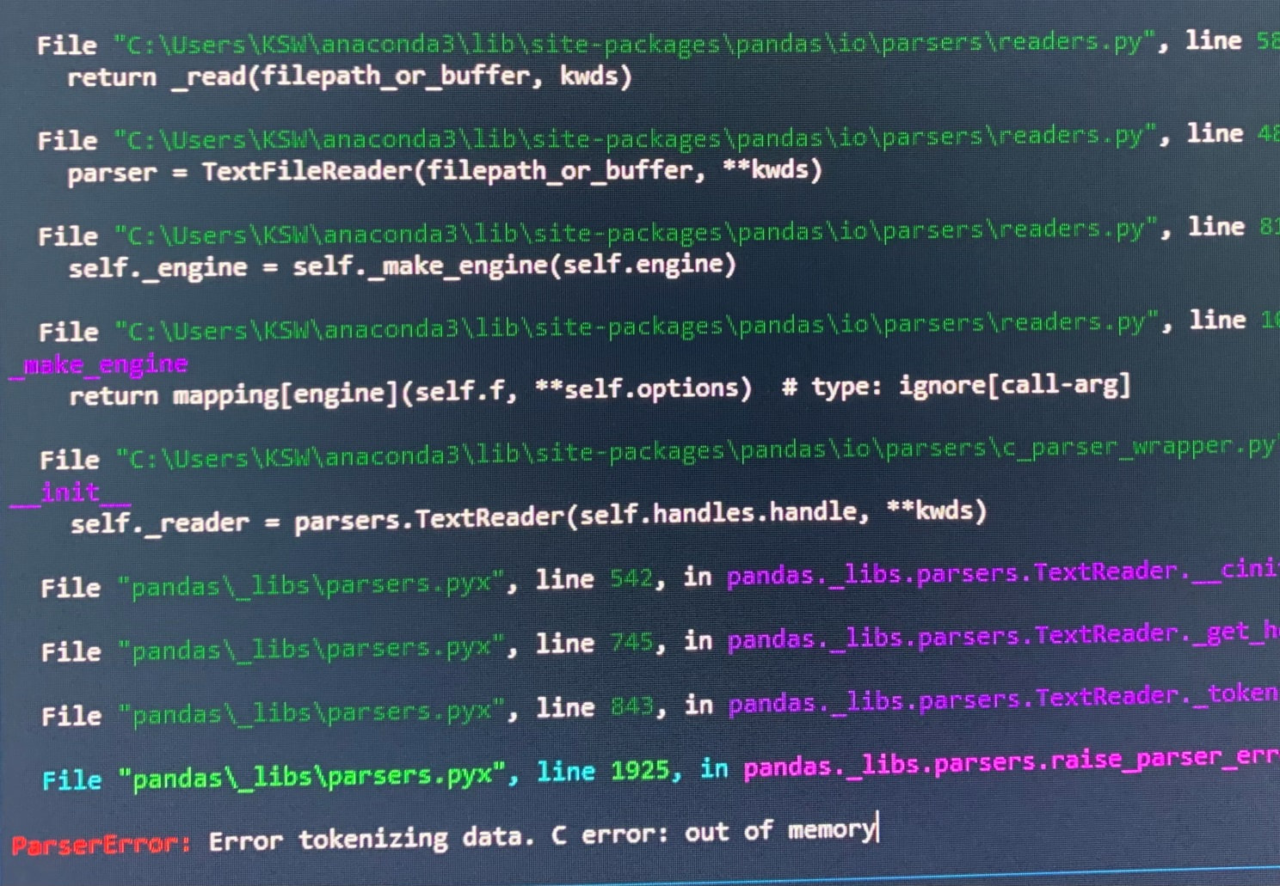
Error

Slide 5
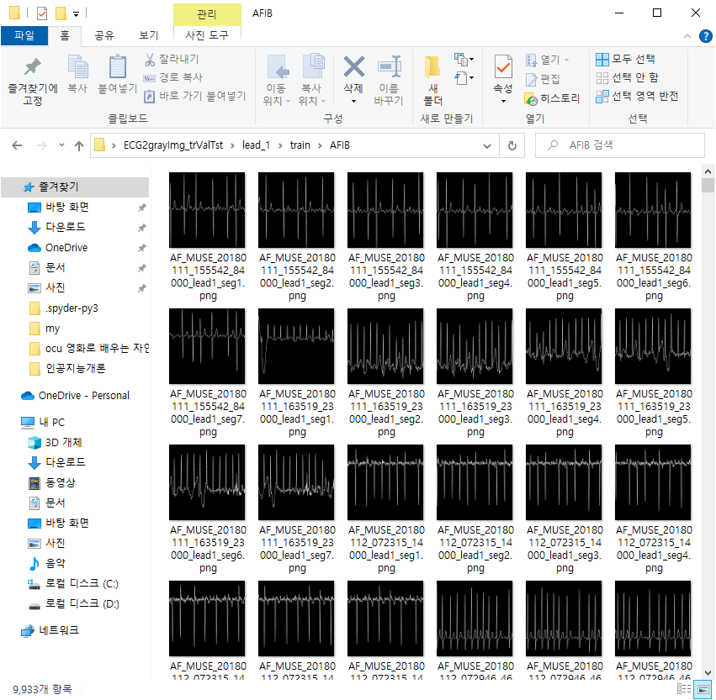
ECG signal data

Slide 6

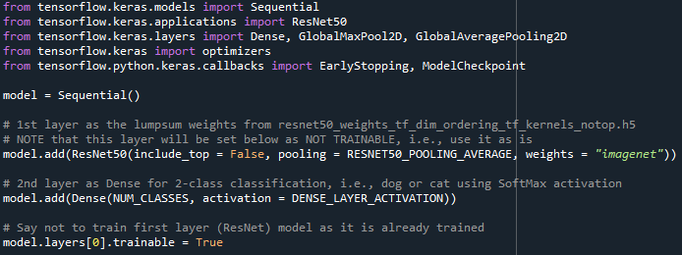
Resnet50

Slide 7

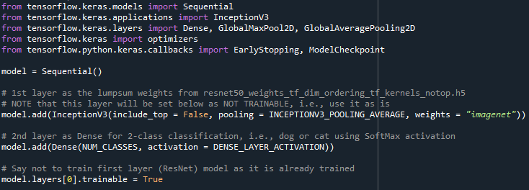
InceptionV3

Slide 8


Resnet50 vs InceptionV3
Res_lead1
Incept_lead1

Slide 9


Res_lead2
Incept_lead2

Slide 10


Res_lead3
Incept_lead3

Slide 11


Res_lead4
Incept_lead4

Slide 12


Res_lead5
Incept_lead5

Slide 13


Res_lead6
Incept_lead6

Slide 14


Res_lead7
Incept_lead7

Slide 15


Res_lead8
Incept_lead8

Slide 16


Res_lead9
Incept_lead9

Slide 17


Res_lead10
Incept_lead10

Slide 18


Res_lead11
Incept_lead11

Slide 19


Res_lead12
Incept_lead12

Slide 20

Resnet50 result

Slide 21

InceptionV3 result

Slide 22
감사합니다

